Slide 1
Data Structures（数据结构）
Preface (前言)
吴东庆
13802985115
QQ：569353284

Slide 2

Outline
先修条件
课程内容
课程资源
Java在本课程中的作用
算法与算法分析
作业管理与评分办法

Slide 3
Prerequisites(先修条件)
The formal prerequisite is
  Basic Programming skill –Java, C/C++, …
If you did not have enough skill for programming ...
  You must try to be familiar with Java programming ASAP.
You are expected to have good Java programming style
  http://java.sun.com/docs/codeconv/html/CodeConvTOC.doc.html

Slide 4
What the course is about（课程内容）
There are four main, interrelated topics in DS:
  Data structures(数据结构)
  Algorithms（算法）
  Analysis of algorithms（算法分析）
  Recursion method（递归）
In addition, we will continue to explore good programming practices
  Good programming style
  Good habits, such as creating test cases
  **Use of tools, such as BlueJ and Eclipse, …

Slide 5
Course Materials（课程资源）
1. ppt(幻灯片)
2. 实验指导书与实验报告模版
3. Workshop Applets(专题课件)
4.教材源码
4. 教材电子版
They are available in
http://gd.nclass.org

Slide 6
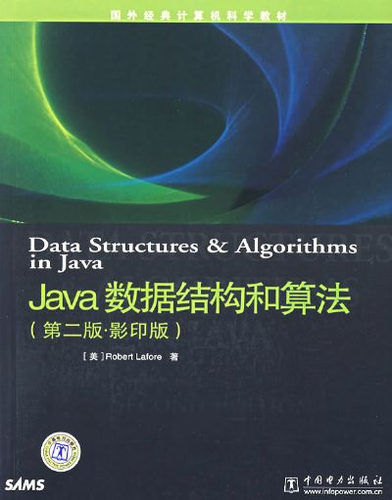
Required textbook #1（教材1）
Data Structures & Algorithms in Java, First/Second Edition, by Robert Lafore, Sams
This book has the clearest and most understandable explanations of algorithms
  Many visualized demos with Applets.

Slide 7
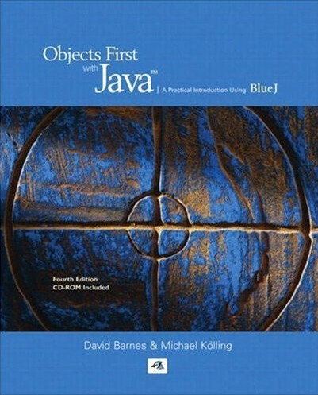
Recommended reading #1 （推荐阅读1）
Objects First with Java:A Practical Introduction Using BlueJ(Fourth Edition ), by David J. Barnes & Michael Kölling
A readable ,in-depth Java book.

Slide 8
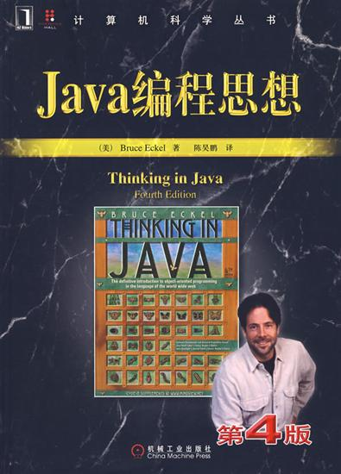
Recommended reading #2（推荐阅读2）
Thinking in Java(4th Edition), by Bruce Eckel
A readable ,in-depth Java book.

Slide 9
Java in this course
This is a course in algorithms and data structures, not a second course in Java
But...
  Java will be the primary（主要的） programming language;
  We may study Java Collections in detail, as they are extremely relevant to the course;
  You will be expected to learn the following IDEs
    BlueJ
    Eclipse

Slide 10

Java Collections（Java的集合类）
Java Collections implement many of the most important data structures for you
  Our data structures course would have you implement some data structures ( classes) by yourself in order to let you have the basic understanding.
  Besides, you need to know how these data structures in Java Collections are implemented.

Slide 11

Algorithms（算法）
There are literally thousands of published algorithms
We will cover:
  a few algorithms that are related to the data structures we are studying
In the future, it’s usually better to find an existing algorithm than to re-invent it yourself.
Don't Re-Invent the Wheel
（别再重复发明轮子！）

Slide 12
Analysis of algorithms（算法分析）
Analysis of algorithms is a relatively small part of this course, but it’s an important part
  You will have another course, Algorithm, for detail.
Analysis can tell you how fast an algorithm will run, and how much space it will require
  Time complexity & Space Complexity （时间复杂度&空间复杂度）.

Slide 13

评分说明
平时成绩 ：30%
  平时作业(书面&程序&实验报告) : 20%
  随堂表现及其它 : 10%
期末考试成绩 ： 70%

Slide 14
平时成绩补充说明
平时作业及随堂表现
  指定作业及随堂测验(5-6次): 验证上课效果
    书面作业必须在指定缴交日前交给学委, 统一由学委将作业及缴交名单交给老师. (default:下一个上课日)
    若为程序作业，缴交日为下一次实验上课时间.
  未缴交者, 该次作业成绩为零分.
  抄袭视同缺交, 该次成绩为零分.
  未参予随堂测验者该次成绩以零分计算.
    除非有佐证资料, 另行考虑; 必要时补考.
随堂表现及其它
  考勤与课堂表现

Slide 15
程序作业补充说明
程序作业内容及评分重点
  按照模板要求写（认真填写实验体会）
  必须在缴交期限前缴交
    延期提交将会严重影响平时成绩！
  所有相关文件一律以压缩档案,在数字大学城提交
    压缩档案命名: 学号_姓名_实验*.zip (或 rar)
    建议个人要有备份, 以免成绩登录有争议.
    如有雷同，无论原版或者被山寨，一律零分！
  作业在数字大学城（gd.nclass.org）提交.要事先注册并选课，才能提交作业。

Slide 16
The End

